Slide 1


Slide 2
At Pucklechurch C of E Primary School, we believe that children should be taught the fundamentals of writing and then, with these secure, move onto crafting and manipulating sentences that express an authorial voice; this should not only be within the realms of English lessons, but throughout the curriculum.

Slide 3
Aims of this morning:
Share our whole school successes in writing.
Share our writing foci.
What does writing look like across the school?

Slide 4
Whole School Writing Successes:
EYFS: 86% children achieved Writing ELG
National: 72%
Year 1: 89% children met Y1 Phonics standard
National: 82%
End of KS1: 82% children achieved the Expected Standard and 38% achieved the Greater Depth Standard
National: EXS 69% GD 15%
End of KS2: 86% children achieved the Expected Standard and 36% achieved the Greater Depth Standard
National: EXS 78% GD 20%

Slide 5
What helps our children become successful writers?
The use of high quality texts or stimuli that link to our theme
Exposure to a wide range of vocabulary and texts
The use of progressive Non-negotiables
Our consistent expectations
Application of skills in the wider curriculum as well as ‘writing sessions’
Being outward facing- close work within our cluster of schools

Slide 6
Whole School Writing Foci:
Children are using their writing skills in the wider curriculum
Children are able to use editing and revising skills to improve their first draft
Improve the level of spelling attainment within all year groups
Whole class reading activities allow children to learn the organisational and language features of genres that feed into their writing
The focus on language and rehearsal of oracy which allows children to practise sentences before writing them

Slide 7
Non-negotiables:
What are they?
What do they look like?
What are the key ones for EYFS, KS1, KS2?
Why are they used?

Slide 8
What are our focuses in writing?

Slide 9
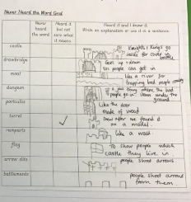
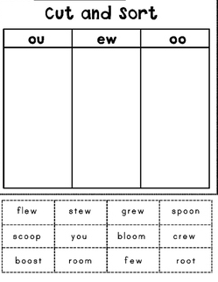
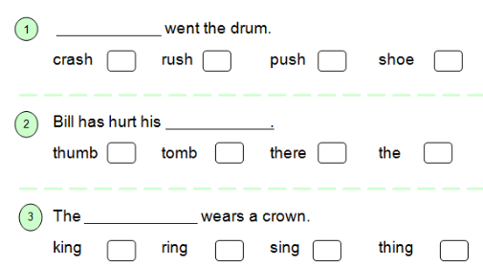
Vocabulary gathering
Explore the vocabulary in a text
Never heard word grids
Cloze activities
Sorting/clumping activities

Slide 10
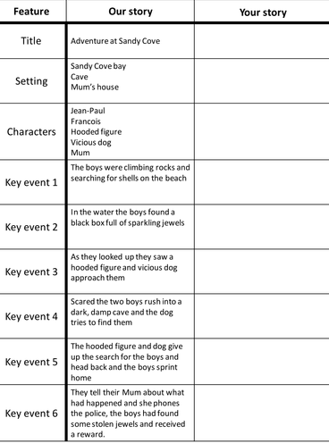
Boxing up
Dissecting a story/ text and thinking about the key parts
Characters
Setting
Problem
Solution
Ending

Slide 11
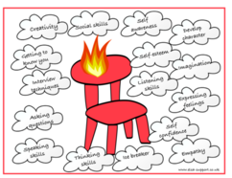
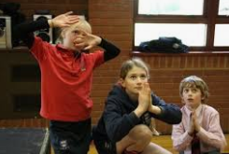
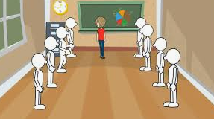
Exploration of a character or setting
Freeze frames
Hot seating
Conscious ally

Slide 12
Character/ setting descriptions
Applying phonics and spellings
Applying punctuation and grammar
Year group non-negotiables such as suffixes, expanded noun phrases
Use of oral rehearsal and key vocabulary

Slide 13

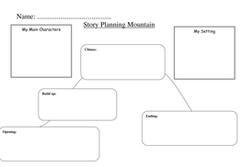
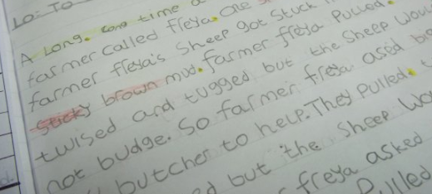
Plan/ draft/ edit/ publish
Plan
Draft and edit
Pubish

Slide 14
How to help your child:
Weekly spellings allow children to use and apply the spelling rules
Exposure of vocabulary through reading will allow children to magpie words that they can use in their own writing

Slide 15
Questions

